Slide 1

Chapter 6
The Link Layer
and LANs
A note on the use of these Powerpoint slides:
We’re making these slides freely available to all (faculty, students, readers). They’re in PowerPoint form so you see the animations; and can add, modify, and delete slides (including this one) and slide content to suit your needs. They obviously represent a lot of work on our part. In return for use, we only ask the following:
Computer Networking: A Top Down Approach
If you use these slides (e.g., in a class) that you mention their source (after all, we’d like people to use our book!)
If you post any slides on a www site, that you note that they are adapted from (or perhaps identical to) our slides, and note our copyright of this material.
Thanks and enjoy! JFK/KWR
All material copyright 1996-2016
J.F Kurose and K.W. Ross, All Rights Reserved
7th edition
Jim Kurose, Keith Ross
Pearson/Addison Wesley
April 2016

Slide 2
Chapter 6: Link layer and LANs
our goals:
understand principles behind link layer services:
  error detection, correction
  sharing a broadcast channel: multiple access
  link layer addressing
  local area networks: Ethernet, VLANs
instantiation, implementation of various link layer technologies

Slide 3
Link layer, LANs: outline
6.1 introduction, services
6.2 error detection, correction
6.3 multiple access protocols
6.4 LANs
  addressing, ARP
  Ethernet
  switches
  VLANS
6.5 data center networking
6.6 a day in the life of a web request

Slide 4








Link layer: introduction
terminology:
hosts and routers: nodes
communication channels that connect adjacent nodes along communication path: links
  wired links
  wireless links
  LANs
layer-2 packet: frame, encapsulates datagram
data-link layer has responsibility of
transferring datagram from one node
to physically adjacent node over a link

Slide 5
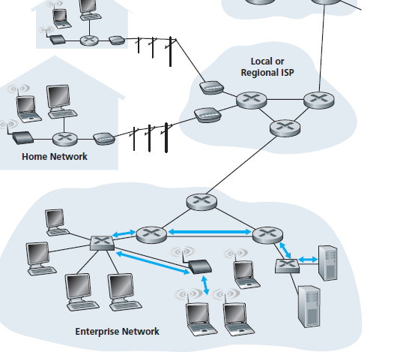
data-link layer has responsibility of
transferring datagram from one node
to physically adjacent node over a link
Example:
Six link-layer hops between wireless host and server.
Frame Relay
Ethernet
Ethernet
Ethernet
Ethernet
Each link protocol provides different services
e.g., may or may not provide rdt over link
WiFi link

Slide 6
Link layer: context
datagram transferred by different link protocols over different links:
  e.g., Ethernet on first link, frame relay on intermediate links, 802.11 on last link
each link protocol provides different services
  e.g., may or may not provide rdt over link
transportation analogy:
trip from Princeton to Lausanne
  limo: Princeton to JFK
  plane: JFK to Geneva
  train: Geneva to Lausanne
tourist = datagram
transport segment = communication link
transportation mode = link layer protocol
travel agent = routing algorithm

Slide 7

Link Layer Services
Framing, Link access:
  encapsulate datagram into frame, adding header, trailer
  Medium access control (MAC) protocol specifies rule for frame transmission
  “MAC” addresses (e.g. 74-29-2F-10-54-1A-FF-0F) used in frame headers to identify source, destination
    different from IP address (e.g.161.139.68.204)!
Reliable delivery between adjacent nodes:
  we learned how to do this already (chapter 3)!
    i.e. acknowledgement and retransmission
  Reliable delivery seldom used on low bit-error link (e.g. fiber, some twisted pair)
  Reliable delivery often used in wireless links: high error rates
MAC (Medium Access Control)

Slide 8
Link layer services
framing, link access:
  encapsulate datagram into frame, adding header, trailer
  channel access if shared medium
  “MAC” addresses used in frame headers to identify source, destination
    different from IP address!
reliable delivery between adjacent nodes
  we learned how to do this already (chapter 3)!
  seldom used on low bit-error link (fiber, some twisted pair)
  wireless links: high error rates
    Q: why both link-level and end-end reliability?

Slide 9
Link layer services (more)
flow control:
  pacing between adjacent sending and receiving nodes
error detection:
  errors caused by signal attenuation, noise.
  receiver detects presence of errors:
    signals sender for retransmission or drops frame
error correction:
  receiver identifies and corrects bit error(s) without resorting to retransmission
half-duplex and full-duplex
  with half duplex, nodes at both ends of link can transmit, but not at same time

Slide 10
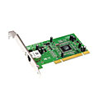


Where is the link layer implemented?
in each and every host
link layer implemented in “adaptor” (aka network interface card NIC) or on a chip
  Ethernet card, 802.11 card; Ethernet chipset
  implements link, physical layer
attaches into host’s system buses
combination of hardware, software, firmware
application
transport
network
link
cpu
memory
link
physical
host
bus
(e.g., PCI)
controller
physical
transmission
network adapter
card

Slide 11
Adaptors communicating
datagram
datagram
controller
controller
sending host
receiving host
datagram
frame
sending side:
  encapsulates datagram in frame
  adds error checking bits, rdt, flow control, etc.
receiving side
  looks for errors, rdt, flow control, etc.
  extracts datagram, passes to upper layer at receiving side

Slide 12
Link layer, LANs: outline
6.1 introduction, services
6.2 error detection, correction
6.3 multiple access protocols
6.4 LANs
  addressing, ARP
  Ethernet
  switches
  VLANS
6.6 data center networking
6.7 a day in the life of a web request

Slide 13
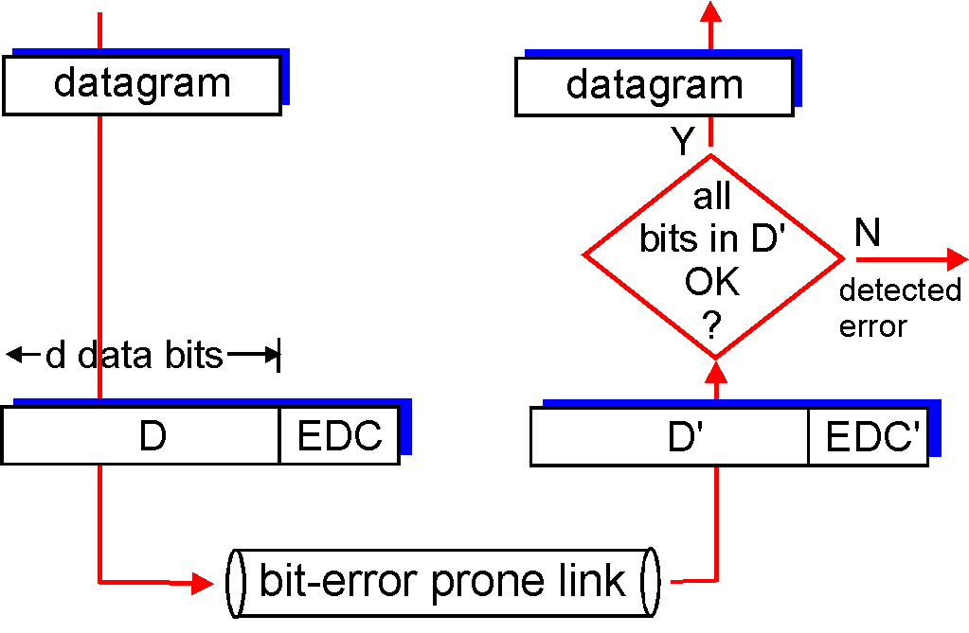
Error detection
EDC= Error Detection and Correction bits (redundancy)
D = Data protected by error checking, may include header fields
Error detection not 100% reliable!
  protocol may miss some errors, but rarely
  larger EDC field yields better detection and correction
otherwise

Slide 14
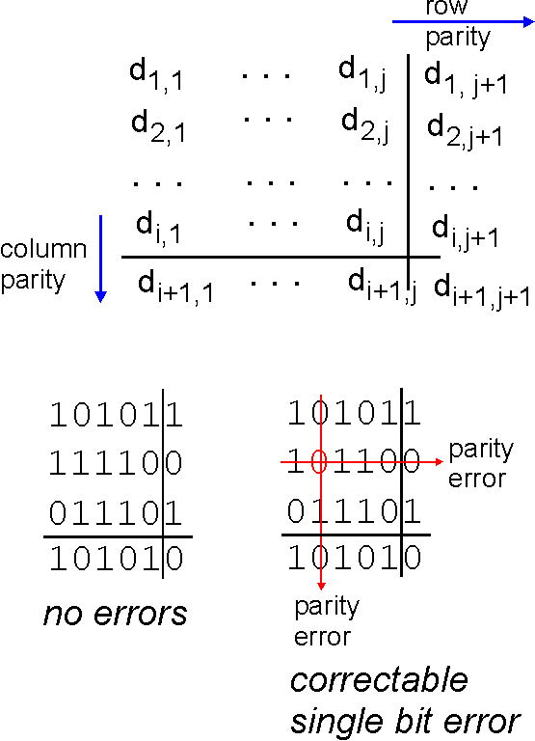
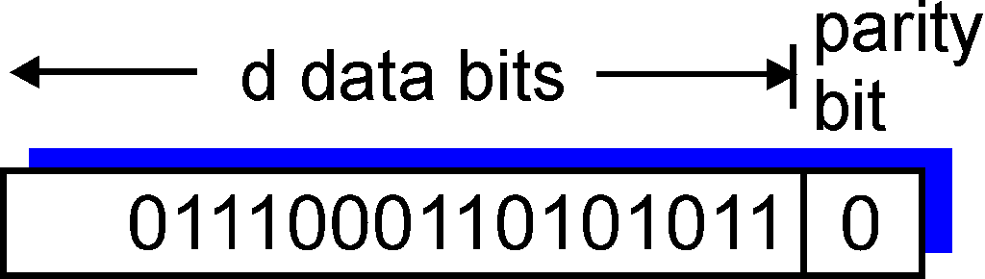
Parity checking
single bit parity:
detect single bit errors
two-dimensional bit parity:
detect and correct single bit errors
0
0
* Check out the online interactive exercises for more examples: http://gaia.cs.umass.edu/kurose_ross/interactive/

Slide 15
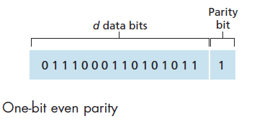
Single Bit Parity:
Detect single bit errors
9 number of bit 1 in data
To make it even ➔ 9 + 1
➔ So parity bit is set to 1
Receiver will count the number of 1s in the received d + 1 bits ➔ and if not the even value ➔ error occured

Slide 16
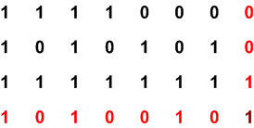
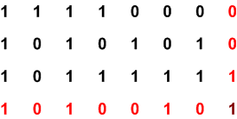
Two-dimensional Bit Parity:
Detect and correct single bit errors
Transmitted data (unprotected):
1111000 1010101 1111111
Even parity
the receiver can take initiative to correct (change) the received message
Received
Error Detected!
Odd parity
Odd parity

Slide 17
Internet checksum (review)
goal: detect “errors” (e.g., flipped bits) in transmitted packet (note: used at transport layer only)
sender:
treat segment contents as sequence of 16-bit integers
checksum: addition (1’s complement sum) of segment contents
sender puts checksum value into UDP checksum field
receiver:
compute checksum of received segment
check if computed checksum equals checksum field value:
  NO - error detected
  YES - no error detected. But maybe errors nonetheless?

Slide 18
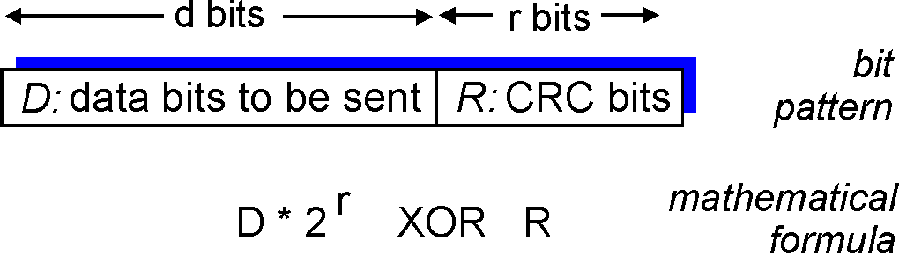
Cyclic redundancy check
more powerful error-detection coding
view data bits, D, as a binary number
choose r+1 bit pattern (generator), G
goal: choose r CRC bits, R, such that
  <D,R> exactly divisible by G (modulo 2)
  receiver knows G, divides <D,R> by G. If non-zero remainder: error detected!
  can detect all burst errors less than r+1 bits
widely used in practice (Ethernet, 802.11 WiFi, ATM)

Slide 19
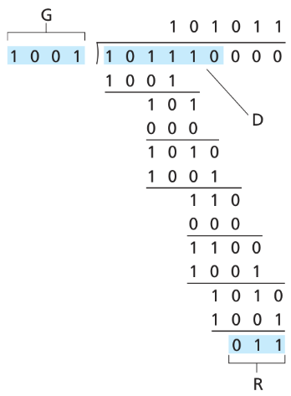

Cyclic redundancy check
Agree with receiver that r = 3 bits
Append 3 zeros (R) to D → 101110000
Agree on G (must be r+1 = 3+1 = 4 bits). Can choose from {1000, 1001, 1010, 1011, 1100, 1101, 1110, 1111} → choose 1001
Get R (r bits)
Append R to D. Send to receiver
Example: @ Sender
101110011
What’s transmitted ?

Slide 20
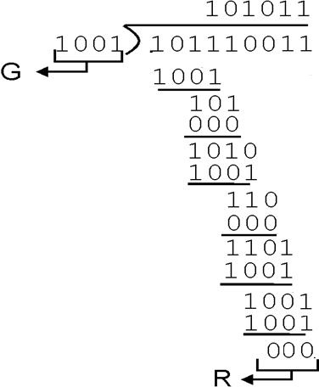

Cyclic redundancy check
Example: @ Receiver
R = 0 → No Error
R ≠ 0 → Error
101110011

Slide 21
Exercise
100111
If the data to be sent is 101110 and the CRC technique is used with r = 3 and G = 1010.
What is the value of R?
What is the data will be sent?
1010
101110000
1010
11
00
110
000
1100
1010
1100
1010
1100
1010
110
Solution:
a) R = 110
b) Data send = 101110110

Slide 22
Exercise
100111
If the data received is 1011101100 and the CRC technique is used with G = 10100.
What is the value of CRC?
Is the data error?
10100
1011101100
10100
110
000
1101
0000
11011
10100
11110
10100
10100
10100
0000
Solution:
a) CRC = 1100
Since zero remainder, there is no error to the data received.

Slide 23
Link layer, LANs: outline
6.1 introduction, services
6.2 error detection, correction
6.3 multiple access protocols
6.4 LANs
  addressing, ARP
  Ethernet
  switches
  VLANS
6.5 data center networking
6.6 a day in the life of a web request

Slide 24




Multiple access links, protocols
two types of “links”:
point-to-point
  PPP for dial-up access
  point-to-point link between Ethernet switch, host
broadcast (shared wire or medium)
  old-fashioned Ethernet
  upstream HFC
  802.11 wireless LAN
shared wire (e.g.,
cabled Ethernet)
shared RF
(e.g., 802.11 WiFi)
shared RF
(satellite)
humans at a
cocktail party
(shared air, acoustical)

Slide 25
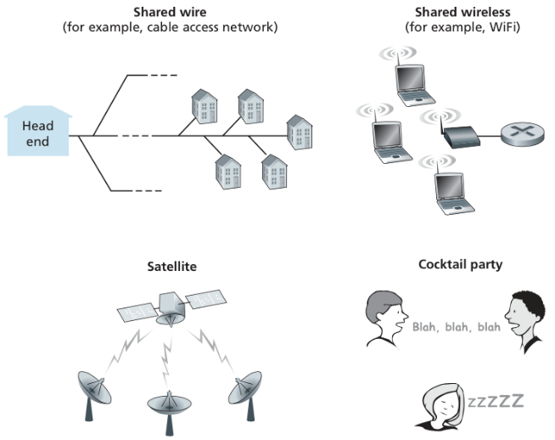
Broadcast: Various multiple access channels.
Figure: Broadcast: Various multiple access channels.

Slide 26
Multiple access protocols
In LANs, WiFi, satellite networks (similar to cocktail party)
  If more than 2 users send message (or talk) @ the same time - collision
  All collided packets are lost -> waste of bandwidth
Thus multiple access protocols are distributed algorithm that determines how nodes utilizes shared broadcast channel,
  i.e., to determine when node can transmit
communication about the channel sharing must use channel itself!
  no out-of-band channel for coordination

Slide 27
Multiple access protocols
single shared broadcast channel
two or more simultaneous transmissions by nodes: interference
  collision if node receives two or more signals at the same time
multiple access protocol
distributed algorithm that determines how nodes share channel, i.e., determine when node can transmit
communication about channel sharing must use channel itself!
  no out-of-band channel for coordination

Slide 28
An ideal multiple access protocol
given: broadcast channel of rate R bps
desiderata:
  1. when one node wants to transmit, it can send at rate R.
  2. when M nodes want to transmit, each can send at average rate R/M
  3. fully decentralized:
    no special node to coordinate transmissions
    no synchronization of clocks, slots
  4. simple

Slide 29
MAC protocols: taxonomy
three broad classes:
channel partitioning
  divide channel into smaller “pieces” (time slots, frequency, code)
  allocate piece to node for exclusive use
random access
  channel not divided, allow collisions
  “recover” from collisions
“taking turns”
  nodes take turns, but nodes with more to send can take longer turns

Slide 30



MAC protocols
MAC Categories
Channel Partitioning Protocols
Random Access Protocols
Taking-Turns Protocols
divide channel into smaller “pieces” (time slots, frequency, code)
allocate piece to node for exclusive use
channel not divided, allow collisions
“recover” from collisions
nodes take turns, but nodes with more to send can take longer turns
CSMA/CA

Slide 31
Channel partitioning MAC protocols: TDMA
TDMA: time division multiple access
access to channel in "rounds"
each station gets fixed length slot (length = packet transmission time) in each round
unused slots go idle
example: 6-station LAN, 1,3,4 have packets to send, slots 2,5,6 idle
6-slot
frame
6-slot
frame
1
3
4
1
3
4

Slide 32
Channel partitioning MAC protocols: FDMA
FDMA: frequency division multiple access
channel spectrum divided into frequency bands
each station assigned fixed frequency band
unused transmission time in frequency bands go idle
example: 6-station LAN, 1,3,4 have packet to send, frequency bands 2,5,6 idle
time
frequency bands
FDM cable

Slide 33
Channel partitioning MAC protocols: CDMA
(a) Channel Partitioning Protocols
CDMA: Code Division Multiple Access
Assigns a different code to each node;
Each node uses its unique code to encode the data bits it sends;
If the code chosen carefully, different nodes can transmit simultaneously;
CDMA has been used in military for some time;
now has widespread civilian use, particularly in cellular telephony (wireless channel)
  … more on Chapter 7

Slide 34
Random access protocols
when node has packet to send
  transmit at full channel data rate R.
  no a priori coordination among nodes
two or more transmitting nodes ➜ “collision”,
random access MAC protocol specifies:
  how to detect collisions
  how to recover from collisions (e.g., via delayed retransmissions)
examples of random access MAC protocols:
  slotted ALOHA
  ALOHA
  CSMA, CSMA/CD, CSMA/CA

Slide 35
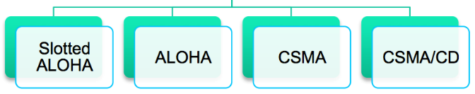
Random access protocols
Random Access Protocols

Slide 36
Slotted ALOHA
assumptions:
all frames same size
time divided into equal size slots (time to transmit 1 frame)
nodes start to transmit only slot beginning
nodes are synchronized
if 2 or more nodes transmit in slot, all nodes detect collision
operation:
when node obtains fresh frame, transmits in next slot
  if no collision: node can send new frame in next slot
  if collision: node retransmits frame in each subsequent slot with prob. p until success

Slide 37
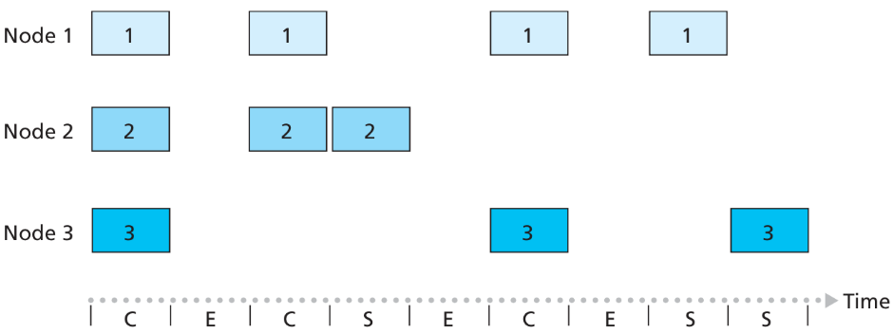


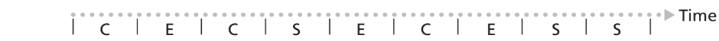
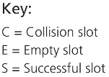
Slotted ALOHA
C
E
C
S
E
C
E
S
S
1 2 3 4 5 6 7 8 9
Slot
Figure: Nodes 1, 2, and 3 collide in the first slot.
Node 2 finally succeeds in the fourth slot,
Node 1 in the eighth slot, and
Node 3 in the ninth slot

Slide 38
Slotted ALOHA
node 1
1
1
1
1
node 2
2
2
2
node 3
3
3
3
C
E
C
S
E
C
E
S
S
Pros:
single active node can continuously transmit at full rate of channel
highly decentralized: only slots in nodes need to be in sync
simple
Cons:
collisions, wasting slots
idle slots
nodes may be able to detect collision in less than time to transmit packet
clock synchronization

Slide 39
Slotted ALOHA: efficiency
efficiency: long-run
fraction of successful slots
(many nodes, all with many frames to send)
max efficiency: find p* that maximizes
Np(1-p)^{N-1}
for many nodes, take limit of Np*(1-p*)^{N-1} as N goes to infinity, gives:
max efficiency = 1/e = .37
suppose: N nodes with many frames to send, each transmits in slot with probability p
prob that given node has success in a slot = p(1-p)^{N-1}
prob that any node has a success = Np(1-p)^{N-1}
at best: channel
used for useful
transmissions 37%
of time!
!

Slide 40
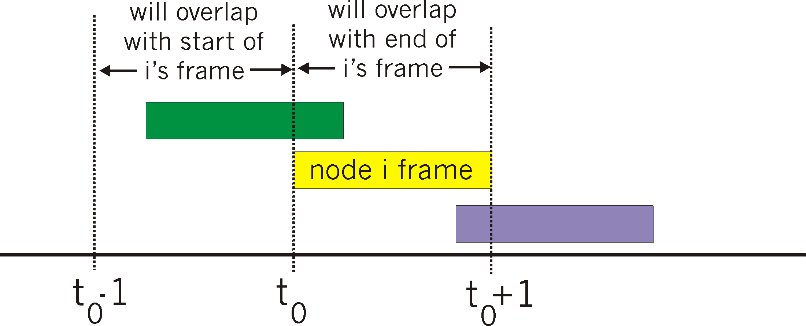
Pure (unslotted) ALOHA
unslotted Aloha: simpler, no synchronization
when frame first arrives
  transmit immediately
collision probability increases:
  frame sent at t₀ collides with other frames sent in [t₀-1,t₀+1]

Slide 41
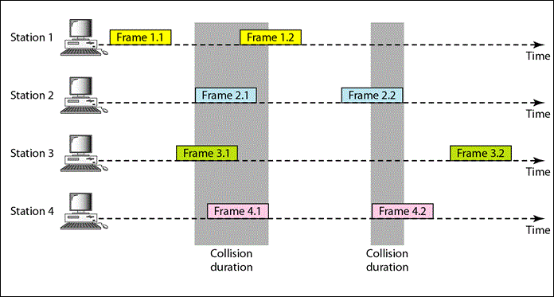
Pure ALOHA (Unslotted)
Example 2:
http://1.bp.blogspot.com/-nS-6P90-iCc/U1DF2Kei3fI/AAAAAAAABp4/guEz45WrJU4/s1600/aloha.GIF

Slide 42
Pure ALOHA efficiency
P(success by given node) = P(node transmits) .
P(no other node transmits in [t₀-1,t₀] .
P(no other node transmits in [t₀-1,t₀]
= p . (1-p)^{N-1 .} (1-p)^{N-1}
= p . (1-p)^{2(N-1)}
… choosing optimum p and then letting n
= 1/(2e) = .18
even worse than slotted Aloha!

Slide 43
CSMA
CSMA: Carrier Sense Multiple Access
Invented to minimize collisions and increase the performance
A station now “follows” the activity of other stations
Simple rules for a polite human conversation
  Listen before talking
  If someone else begins talking at the same time as you, stop talking

Slide 44
CSMA (carrier sense multiple access)
CSMA: listen before transmit:
if channel sensed idle: transmit entire frame
if channel sensed busy, defer transmission
human analogy: don’t interrupt others!

Slide 45
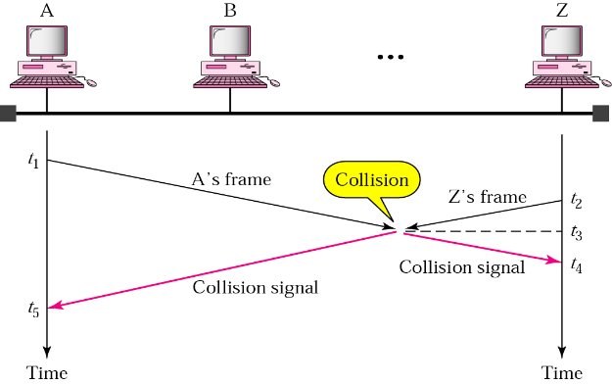
CSMA
If everyone is sensing the medium how come that collisions still occur?
channel propagation delay

Slide 46
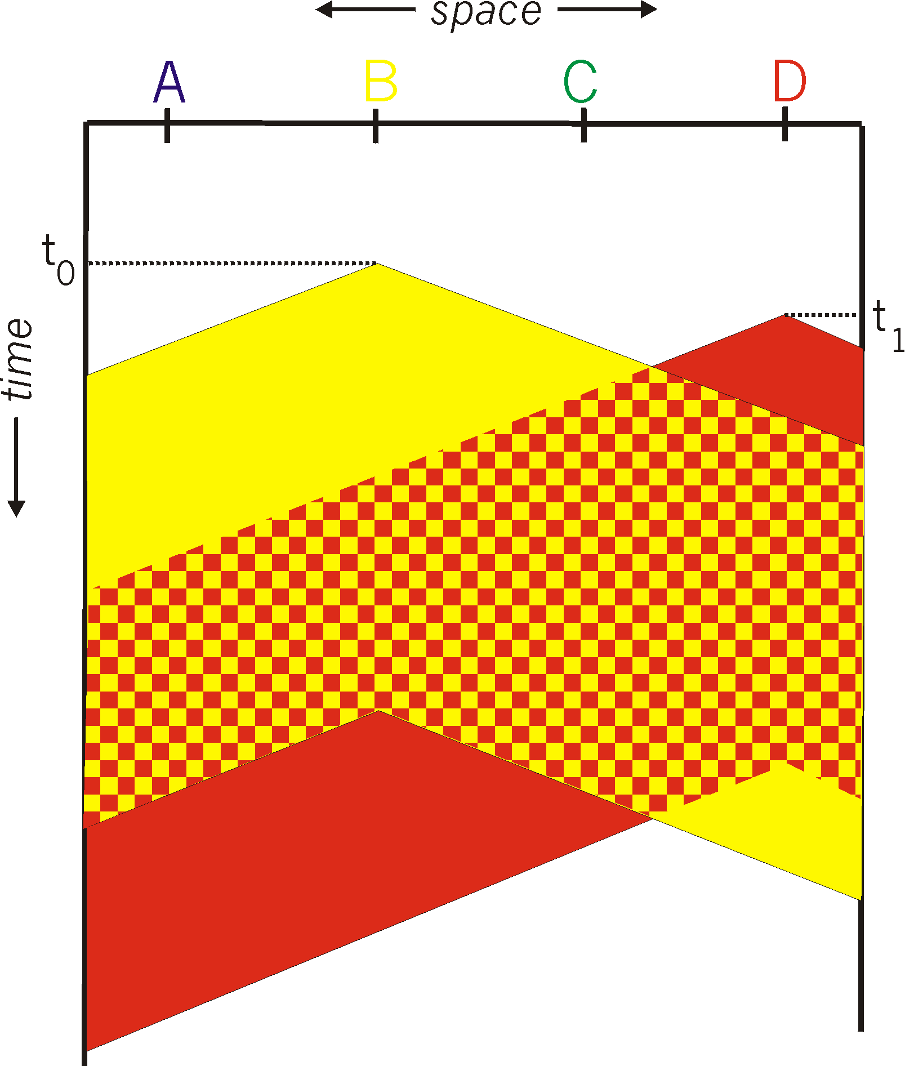
CSMA collisions
spatial layout of nodes
collisions can still occur: propagation delay means two nodes may not hear each other’s transmission
collision: entire packet transmission time wasted
  distance & propagation delay play role in in determining collision probability

Slide 47
CSMA/CD (collision detection)
CSMA/CD: carrier sensing, deferral as in CSMA
  collisions detected within short time
  colliding transmissions aborted, reducing channel wastage
collision detection:
  easy in wired LANs: measure signal strengths, compare transmitted, received signals
  difficult in wireless LANs: received signal strength overwhelmed by local transmission strength
human analogy: the polite conversationalist

Slide 48
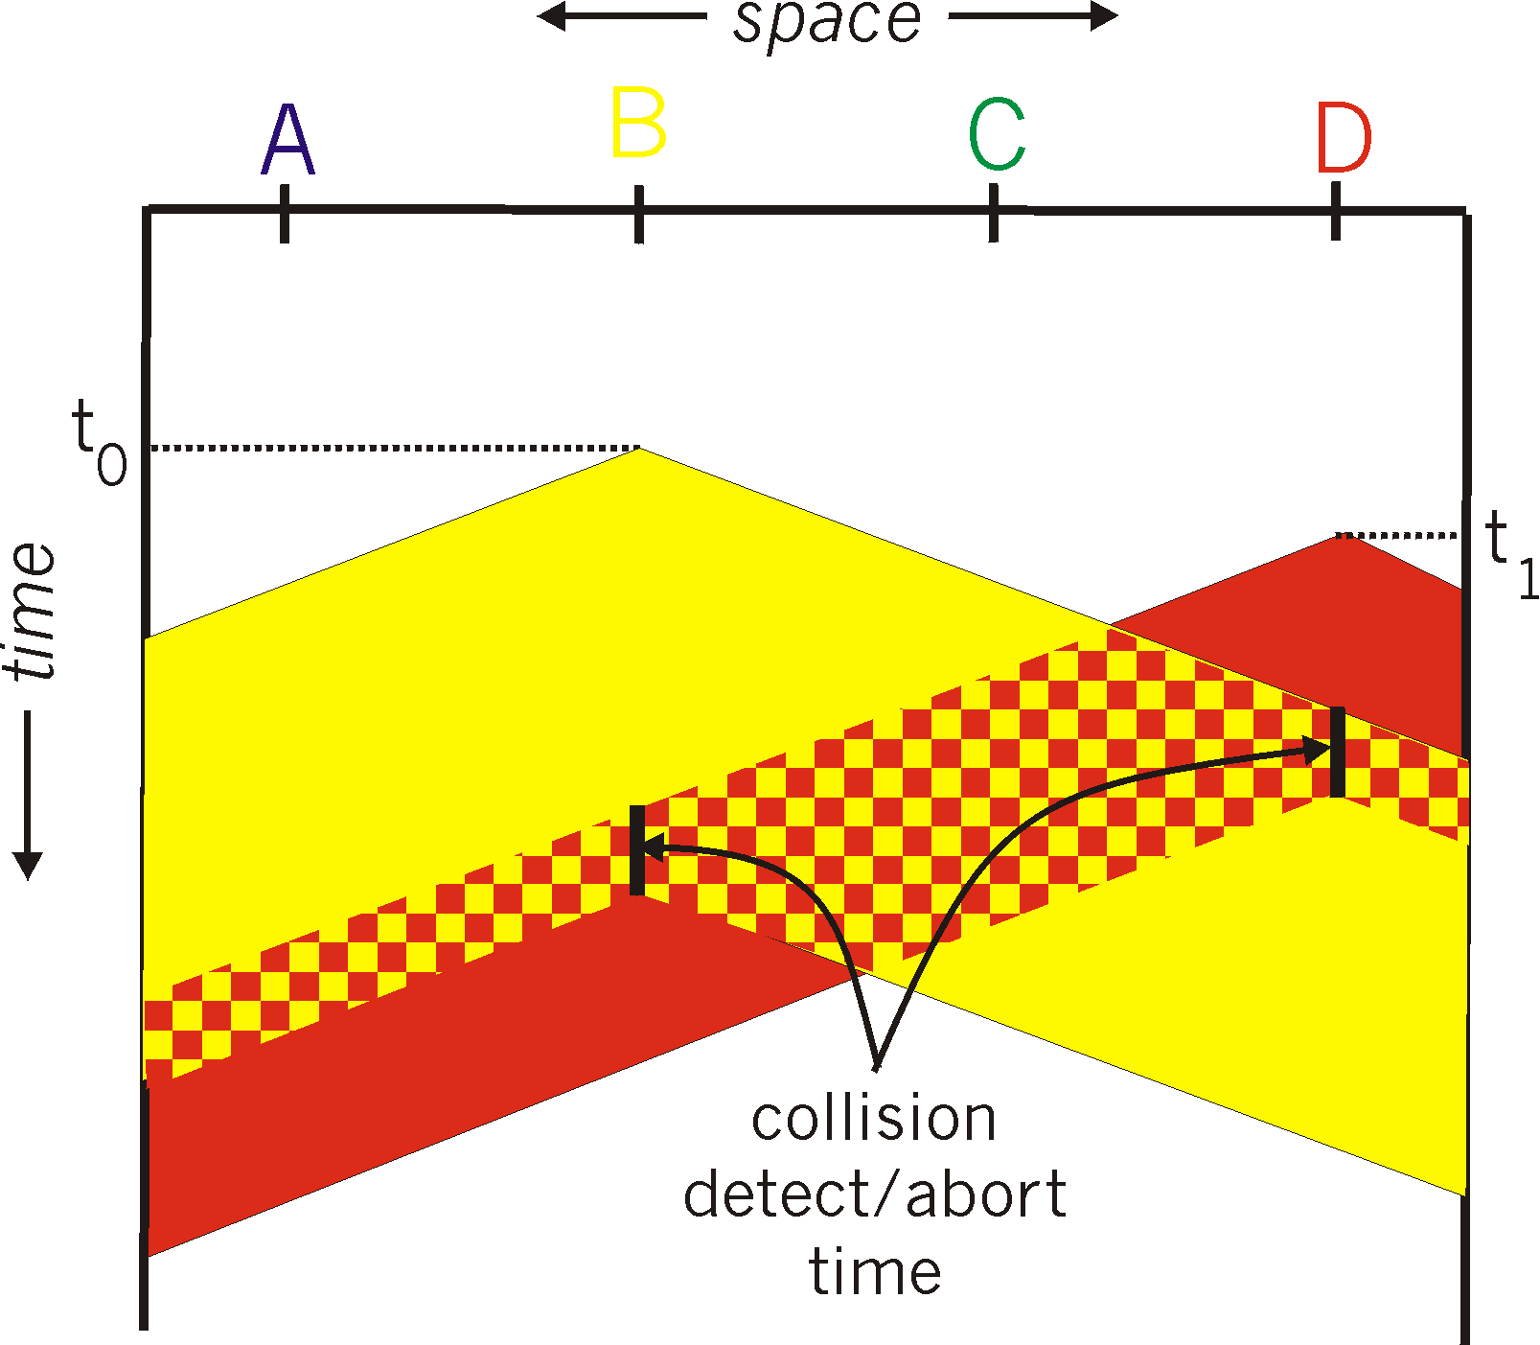
CSMA/CD (collision detection)
spatial layout of nodes

Slide 49
Ethernet CSMA/CD algorithm
1. NIC receives datagram from network layer, creates frame
2. If NIC senses channel idle, starts frame transmission. If NIC senses channel busy, waits until channel idle, then transmits.
3. If NIC transmits entire frame without detecting another transmission, NIC is done with frame !
4. If NIC detects another transmission while transmitting, aborts and sends jam signal
5. After aborting, NIC enters binary (exponential) backoff:
  after mth collision, NIC chooses K at random from {0,1,2, …, 2^{m}-1}. NIC waits K·512 bit times, returns to Step 2
  longer backoff interval with more collisions

Slide 50
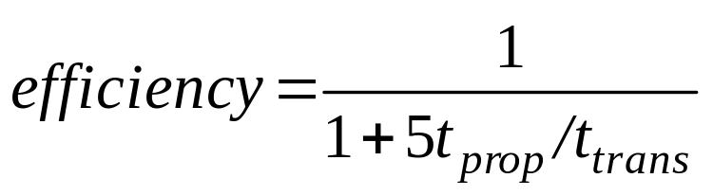
CSMA/CD efficiency
T_{prop} = max prop delay between 2 nodes in LAN
t_{trans} = time to transmit max-size frame
efficiency goes to 1
  as t_{prop} goes to 0
  as t_{trans} goes to infinity
better performance than ALOHA: and simple, cheap, decentralized!

Slide 51
“Taking turns” MAC protocols
channel partitioning MAC protocols:
  share channel efficiently and fairly at high load
  inefficient at low load: delay in channel access, 1/N bandwidth allocated even if only 1 active node!
random access MAC protocols
  efficient at low load: single node can fully utilize channel
  high load: collision overhead
“taking turns” protocols
  look for best of both worlds!

Slide 52

“Taking turns” MAC protocols
polling:
master node “invites” slave nodes to transmit in turn
typically used with “dumb” slave devices
concerns:
  polling overhead
  latency
  single point of failure (master)
data
poll
master
data
slaves

Slide 53
“Taking turns” MAC protocols
token passing:
control token passed from one node to next sequentially.
token message
concerns:
  token overhead
  latency
  single point of failure (token)
T
(nothing
to send)
T
data

Slide 54



Cable access network
Internet frames, TV channels, control transmitted
downstream at different frequencies
cable headend
…
CMTS
…
splitter
cable
modem
cable modem
termination system
ISP
upstream Internet frames, TV control, transmitted
upstream at different frequencies in time slots
multiple 40Mbps downstream (broadcast) channels
  single CMTS transmits into channels
multiple 30 Mbps upstream channels
  multiple access: all users contend for certain upstream channel time slots (others assigned)

Slide 55



Cable access network
cable headend
MAP frame for
Interval [t1, t2]
CMTS
Downstream channel i
Upstream channel j
t₁
t₂
Residences with cable modems
Minislots containing
minislots request frames
Assigned minislots containing cable modem
upstream data frames
DOCSIS: data over cable service interface spec
FDM over upstream, downstream frequency channels
TDM upstream: some slots assigned, some have contention
  downstream MAP frame: assigns upstream slots
  request for upstream slots (and data) transmitted random access (binary backoff) in selected slots

Slide 56
Summary of MAC protocols
channel partitioning, by time, frequency or code
  Time Division, Frequency Division
random access (dynamic),
  ALOHA, S-ALOHA, CSMA, CSMA/CD
  carrier sensing: easy in some technologies (wire), hard in others (wireless)
  CSMA/CD used in Ethernet
  CSMA/CA used in 802.11
taking turns
  polling from central site, token passing
  Bluetooth, FDDI, token ring

Slide 57
Link layer, LANs: outline
6.1 introduction, services
6.2 error detection, correction
6.3 multiple access protocols
6.4 LANs
  addressing, ARP
  Ethernet
  switches
  VLANS
6.5 data center networking
6.6 a day in the life of a web request

Slide 58
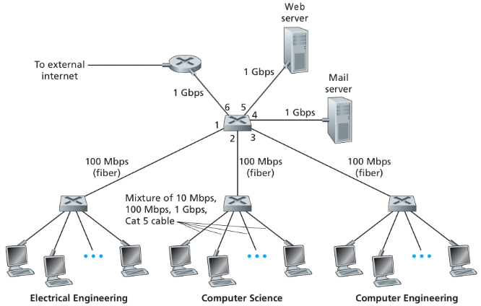
Switched Local Area Networks
Having covered broadcast networks and multiple access protocols (MAC) in previous section;
Switches operate at the link layer :
switch link-layer frames;
not recognize network-layer addresses
not use routing algorithms
Use link-layer addresses
Figure: An institutional network connected together by four switches.

Slide 59
MAC addresses and ARP
Hosts and routers have link-layer addresses ?
32-bit IP address:
  network-layer address for interface
  used for layer 3 (network layer) forwarding
MAC (or LAN or physical or Ethernet) address:
  function: used ‘locally” to get frame from one interface to another physically-connected interface (same network, in IP-addressing sense)
  48 bit MAC address (for most LANs) burned in NIC ROM, also sometimes software settable
  e.g.: 1A-2F-BB-76-09-AD
hexadecimal (base 16) notation
(each “numeral” represents 4 bits)

Slide 60

LAN addresses and ARP
each adapter on LAN has unique LAN address
1A-2F-BB-76-09-AD
LAN
(wired or
wireless)
Adapter (interface)
71-65-F7-2B-08-53
58-23-D7-FA-20-B0
0C-C4-11-6F-E3-98
Each interface connected to a LAN has a unique MAC address

Slide 61
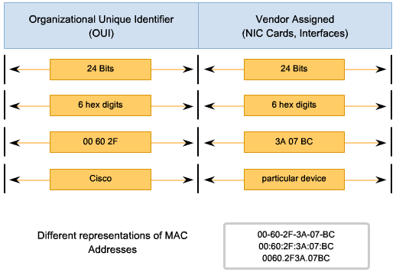
LAN / MAC addresses
Every pieces of Ethernet hardware has the address “burned in” to a chip on the hardware.
The first 3 bytes of an Ethernet address are the manufacturer’s code and the last 3 bytes are a unique sequence number.

Slide 62
LAN addresses (more)
MAC address allocation administered by IEEE
manufacturer buys portion of MAC address space (to assure uniqueness)
analogy:
  MAC address: like Social Security Number
  IP address: like postal address
MAC flat address ➜ portability
  can move LAN card from one LAN to another
IP hierarchical address not portable
  address depends on IP subnet to which node is attached

Slide 63




ARP: address resolution protocol
Question: how to determine
interface’s MAC address, knowing its IP address?
ARP table: each IP node (host, router) on LAN has table
  IP/MAC address mappings for some LAN nodes:
< IP address; MAC address; TTL>
  TTL (Time To Live): time after which address mapping will be forgotten (typically 20 min)
137.196.7.78
1A-2F-BB-76-09-AD
137.196.7.23
137.196.7.14
LAN
71-65-F7-2B-08-53
58-23-D7-FA-20-B0
0C-C4-11-6F-E3-98
137.196.7.88

Slide 64
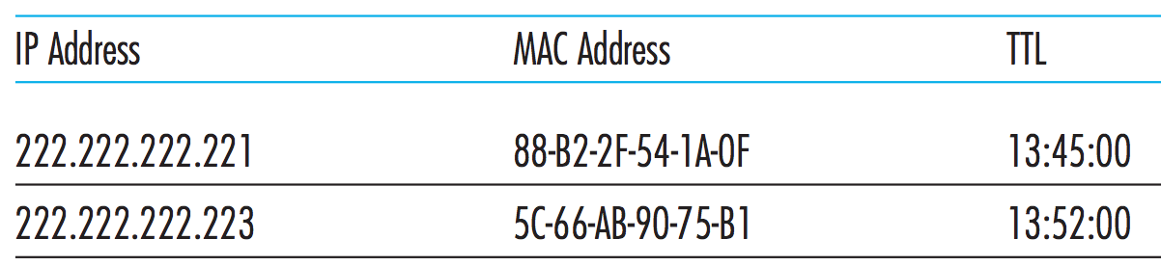
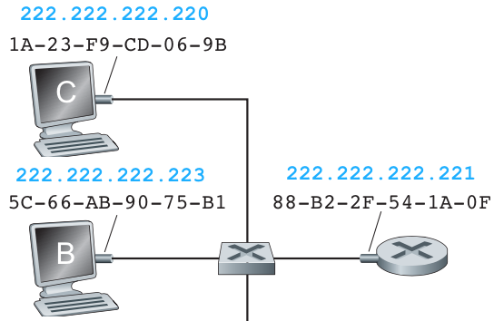
ARP: address resolution protocol
Link Layer Addressing and Address Resolution Protocol (ARP)
Figure: A possible ARP table in 222.222.222.220

Slide 65
ARP protocol: same LAN
A wants to send datagram to B
  B’s MAC address not in A’s ARP table.
A broadcasts ARP query packet, containing B's IP address
  destination MAC address = FF-FF-FF-FF-FF-FF
  all nodes on LAN receive ARP query
B receives ARP packet, replies to A with its (B's) MAC address
  frame sent to A’s MAC address (unicast)
A caches (saves) IP-to-MAC address pair in its ARP table until information becomes old (times out)
  soft state: information that times out (goes away) unless refreshed
ARP is “plug-and-play”:
  nodes create their ARP tables without intervention from net administrator

Slide 66
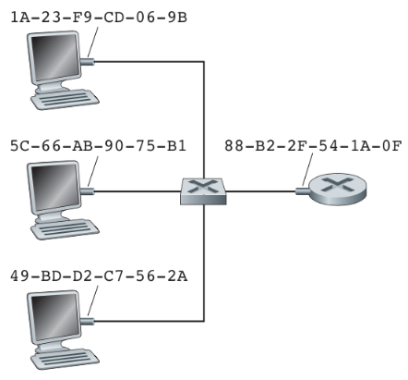
ARP protocol: same LAN
?
B
176.16.3.2
176.16.3.100
A wants to send datagram to B
B’s MAC address is not in A’s ARP table.
B
176.16.3.1
A

Slide 67
ARP protocol: same LAN
B receives ARP packet, replies to A with its (B's) MAC address
  frame sent to A’s MAC address (unicast)
I heard that broadcast. The message is for me. Here is my Ethernet address.
IP: 176.16.3.2
MAC: 1A-23-F9-CD-06-9B
?
B
A broadcasts ARP query packet, containing;
  B's IP address, and MAC address
  = FF-FF-FF-FF-FF-FF all nodes on LAN receive ARP query
176.16.3.2
176.16.3.100
B
176.16.3.1
I need the Ethernet address of 176.16.3.2.
A
IP: 176.16.3.2
MAC: FF-FF-FF-FF-FF-FF

Slide 68
Link Layer Addressing and Address Resolution Protocol (ARP)
ARP protocol: same LAN
A caches (saves) IP-to-MAC address pair in its ARP table until times out
ARP is “plug-and-play”:
  nodes create their ARP tables without intervention from network administrator
176.16.3.2
B
176.16.3.100
B
176.16.3.1
A

Slide 69




Addressing: routing to another LAN
walkthrough: send datagram from A to B via R
  focus on addressing – at IP (datagram) and MAC layer (frame)
  assume A knows B’s IP address
  assume A knows IP address of first hop router, R (how?)
  assume A knows R’s MAC address (how?)
A
B
R
111.111.111.111
222.222.222.222
74-29-9C-E8-FF-55
49-BD-D2-C7-56-2A
222.222.222.220
1A-23-F9-CD-06-9B
111.111.111.112
111.111.111.110
222.222.222.221
CC-49-DE-D0-AB-7D
E6-E9-00-17-BB-4B
88-B2-2F-54-1A-0F

Slide 70
Addressing: routing to another LAN
A creates IP datagram with IP source A, destination B
A creates link-layer frame with R's MAC address as destination address, frame contains A-to-B IP datagram
MAC src: 74-29-9C-E8-FF-55
MAC dest: E6-E9-00-17-BB-4B
IP
Eth
Phy
IP src: 111.111.111.111
IP dest: 222.222.222.222
A
B
R
111.111.111.111
222.222.222.222
74-29-9C-E8-FF-55
49-BD-D2-C7-56-2A
222.222.222.220
1A-23-F9-CD-06-9B
111.111.111.112
111.111.111.110
222.222.222.221
CC-49-DE-D0-AB-7D
E6-E9-00-17-BB-4B
88-B2-2F-54-1A-0F

Slide 71
Addressing: routing to another LAN
frame sent from A to R
frame received at R, datagram removed, passed up to IP
MAC src: 74-29-9C-E8-FF-55
MAC dest: E6-E9-00-17-BB-4B
IP src: 111.111.111.111
IP dest: 222.222.222.222
IP
Eth
Phy
IP src: 111.111.111.111
IP dest: 222.222.222.222
IP
Eth
Phy
A
B
R
111.111.111.111
222.222.222.222
74-29-9C-E8-FF-55
49-BD-D2-C7-56-2A
222.222.222.220
1A-23-F9-CD-06-9B
111.111.111.112
111.111.111.110
222.222.222.221
CC-49-DE-D0-AB-7D
E6-E9-00-17-BB-4B
88-B2-2F-54-1A-0F

Slide 72
Addressing: routing to another LAN
R forwards datagram with IP source A, destination B
R creates link-layer frame with B's MAC address as destination address, frame contains A-to-B IP datagram
MAC src: 1A-23-F9-CD-06-9B
MAC dest: 49-BD-D2-C7-56-2A
IP
Eth
Phy
IP
Eth
Phy
IP src: 111.111.111.111
IP dest: 222.222.222.222
A
B
R
111.111.111.111
222.222.222.222
74-29-9C-E8-FF-55
49-BD-D2-C7-56-2A
222.222.222.220
1A-23-F9-CD-06-9B
111.111.111.112
111.111.111.110
222.222.222.221
CC-49-DE-D0-AB-7D
E6-E9-00-17-BB-4B
88-B2-2F-54-1A-0F

Slide 73
Addressing: routing to another LAN
R forwards datagram with IP source A, destination B
R creates link-layer frame with B's MAC address as destination address, frame contains A-to-B IP datagram
MAC src: 1A-23-F9-CD-06-9B
MAC dest: 49-BD-D2-C7-56-2A
IP
Eth
Phy
IP
Eth
Phy
IP src: 111.111.111.111
IP dest: 222.222.222.222
A
B
R
111.111.111.111
222.222.222.222
74-29-9C-E8-FF-55
49-BD-D2-C7-56-2A
222.222.222.220
1A-23-F9-CD-06-9B
111.111.111.112
111.111.111.110
222.222.222.221
CC-49-DE-D0-AB-7D
E6-E9-00-17-BB-4B
88-B2-2F-54-1A-0F

Slide 74
Addressing: routing to another LAN
R forwards datagram with IP source A, destination B
R creates link-layer frame with B's MAC address as dest, frame contains A-to-B IP datagram
MAC src: 1A-23-F9-CD-06-9B
MAC dest: 49-BD-D2-C7-56-2A
IP src: 111.111.111.111
IP dest: 222.222.222.222
IP
Eth
Phy
A
B
R
111.111.111.111
222.222.222.222
74-29-9C-E8-FF-55
49-BD-D2-C7-56-2A
222.222.222.220
1A-23-F9-CD-06-9B
111.111.111.112
111.111.111.110
222.222.222.221
CC-49-DE-D0-AB-7D
E6-E9-00-17-BB-4B
88-B2-2F-54-1A-0F
* Check out the online interactive exercises for more examples: http://gaia.cs.umass.edu/kurose_ross/interactive/

Slide 75
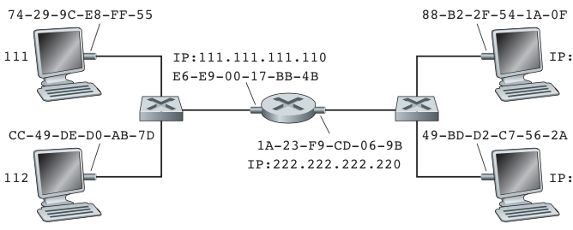
Link Layer Addressing and Address Resolution Protocol (ARP)
Addressing: routing to another LAN
Link-layer frame
src:74-29—9C-E8-FF-55
dest:E6-E9-00-17-BB-4B
Link-layer frame
src:1A-23—F9-CD-06-9B
dest:88-B2-2F-54-1A-0F
IP datagram
src:111.111.111.111
dest:222.222.222.221
IP datagram
src:111.111.111.111
dest:222.222.222.221
IP:111.111.111.111
IP:222.222.222.221
A
IP:111.111.111.110
B
IP:222.222.222.220
Figure: 2 subnets interconnected by a router.

Slide 76
Exercise
Suppose A sends frame to B.
a) What is the source and destination IP address at X and Y ?
b) What is the source and destination Ethernet address at X
and Y ?
IP:111.111.111.111
IP:222.222.222.221
A
IP:111.111.111.110
Y
IP:111.111.111.112
X
IP:222.222.222.222
IP:222.222.222.220
B

Slide 77
Solution
a) What is the source and destination IP address at X and Y ?
IP address X Y
source :
destination :
111.111.111.111
222.222.222.222
111.111.111.111
222.222.222.222
IP:111.111.111.111
IP:222.222.222.221
A
IP:111.111.111.110
Y
IP:111.111.111.112
X
IP:222.222.222.222
IP:222.222.222.220
B

Slide 78
Solution
b) What is the source and destination Ethernet address at X and Y ?
Ethernet address X Y
source :
destination :
74-29-9C-E8-FF-55
E6-E9-00-17-BB-4B
1A-23-F9-CD-06-9B
49-BD-D2-C7-56-2A
IP:111.111.111.111
IP:222.222.222.221
A
IP:111.111.111.110
Y
IP:111.111.111.112
X
IP:222.222.222.222
IP:222.222.222.220
B

Slide 79
Link layer, LANs: outline
6.1 introduction, services
6.2 error detection, correction
6.3 multiple access protocols
6.4 LANs
  addressing, ARP
  Ethernet
  switches
  VLANS
6.5 data center networking
6.6 a day in the life of a web request

Slide 80
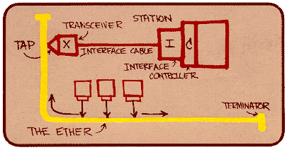

Ethernet
“dominant” wired LAN technology:
single chip, multiple speeds (e.g., Broadcom BCM5761)
first widely used LAN technology
simpler, cheap
kept up with speed race: 10 Mbps – 10 Gbps
Metcalfe’s Ethernet sketch

Slide 81



Ethernet: physical topology
bus: popular through mid 90s
  all nodes in same collision domain (can collide with each other)
star: prevails today
  active switch in center
  each “spoke” runs a (separate) Ethernet protocol (nodes do not collide with each other)
switch
bus: coaxial cable

Slide 82
Ethernet frame structure
sending adapter encapsulates IP datagram (or other network layer protocol packet) in Ethernet frame
preamble:
7 bytes with pattern 10101010 followed by one byte with pattern 10101011
used to synchronize receiver, sender clock rates
type
preamble
dest.
address
source
address
data (payload)
CRC

Slide 83
Ethernet frame structure (more)
addresses: 6 byte source, destination MAC addresses
  if adapter receives frame with matching destination address, or with broadcast address (e.g. ARP packet), it passes data in frame to network layer protocol
  otherwise, adapter discards frame
type: indicates higher layer protocol (mostly IP but others possible, e.g., Novell IPX, AppleTalk)
CRC: cyclic redundancy check at receiver
  error detected: frame is dropped
Data (payload) (46 – 1500bytes)
Min size: 46 bytes
Max size: 1500 bytes (MTU size)
type
preamble
dest.
address
source
address
data (payload)
CRC

Slide 84
Ethernet: unreliable, connectionless
connectionless: no handshaking between sending and receiving NICs
unreliable: receiving NIC doesn't send acks or nacks to sending NIC
  data in dropped frames recovered only if initial sender uses higher layer rdt (e.g., TCP), otherwise dropped data lost
Ethernet’s MAC protocol: unslotted CSMA/CD with binary backoff

Slide 85
802.3 Ethernet standards: link & physical layers
many different Ethernet standards
  common MAC protocol and frame format
  different speeds: 2 Mbps, 10 Mbps, 100 Mbps, 1Gbps, 10 Gbps, 40 Gbps
  different physical layer media: fiber, copper twister pair cable
application
transport
network
link
physical
MAC protocol
and frame format
100BASE-TX
100BASE-T2
100BASE-FX
100BASE-T4
100BASE-SX
100BASE-BX
copper (twister
pair) physical layer
fiber physical layer

Slide 86
Link layer, LANs: outline
6.1 introduction, services
6.2 error detection, correction
6.3 multiple access protocols
6.4 LANs
  addressing, ARP
  Ethernet
  switches
  VLANS
6.5 data center networking
6.6 a day in the life of a web request

Slide 87
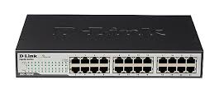
Ethernet switch
link-layer device: takes an active role
  store, forward Ethernet frames
  examine incoming frame’s MAC address, selectively forward frame to one-or-more outgoing links when frame is to be forwarded on segment, uses CSMA/CD to access segment
transparent
  hosts are unaware of presence of switches
plug-and-play, self-learning
  switches do not need to be configured

Slide 88
Switch: multiple simultaneous transmissions
hosts have dedicated, direct connection to switch
switches buffer packets
Ethernet protocol used on each incoming link, but no collisions; full duplex
  each link is its own collision domain
switching: A-to-A’ and B-to-B’ can transmit simultaneously, without collisions
A
C’
B
6
1
2
5
4
3
B’
C
A’
switch with six interfaces
(1,2,3,4,5,6)

Slide 89
Switch forwarding table
Q: how does switch know A’ reachable via interface 4, B’ reachable via interface 5?
A
C’
B
A: each switch has a switch table, each entry:
  (MAC address of host, interface to reach host, time stamp)
  looks like a routing table!
6
1
2
5
4
3
B’
C
A’
Q: how are entries created, maintained in switch table?
  something like a routing protocol?
switch with six interfaces
(1,2,3,4,5,6)

Slide 90
Switch: self-learning
Source: A
Dest: A’
switch learns which hosts can be reached through which interfaces
  when frame received, switch “learns” location of sender: incoming LAN segment
  records sender/location pair in switch table
A
A A’
C’
B
6
1
2
5
4
3
B’
C
A’
MAC addr interface TTL
A
1
60
Switch table
(initially empty)

Slide 91
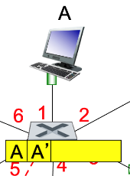

Switch: frame filtering/forwarding
when frame received at switch:
  1. record incoming link, MAC address of sending host
  2. index switch table using MAC destination address
  3. if entry found for destination
  then {
  if destination on segment from which frame arrived
  then drop frame
  else forward frame on interface indicated by entry
  }
  else flood /* forward on all interfaces except arriving
  interface */

Slide 92
Self-learning, forwarding: example
Source: A
Dest: A’
A
A A’
frame destination, A’, location unknown:
flood
C’
B
destination A location known:
6
1
2
A A’
A A’
A A’
A A’
selectively send
on just one link
A A’
5
4
3
B’
C
A’ A
A’
MAC addr interface TTL
A
1
60
switch table
(initially empty)
A’
4
60

Slide 93


Interconnecting switches
self-learning switches can be connected together:
S₄
S₁
S₃
A
S₂
F
I
B
C
D
E
G
H
Q: sending from A to G - how does S₁ know to forward frame destined to G via S₄ and S₃?
A: self learning! (works exactly the same as in single-switch case!)

Slide 94
Exercise
Suppose A sends frame to G, G responds to A.
Show the switch tables in S₁, S₃, S₄
S₄
Solution:
self learning! (works exactly the same as in single-switch case!)
5
7
6
S₁
12
S₃
1
4
S₂
8
15
A
2
3
9
13
14
10
11
J
G
B
C
D
F
H
E

Slide 95
Solution
Suppose A sends frame to G, G responds to A.
Show the switch tables in S₁, S₃, S₄
S₄
Solution:
self learning! (works exactly the same as in single-switch case!)
5
7
6
S₁
12
S₃
1
4
S₂
8
15
A
2
3
9
13
14
10
11
J
G
B
C
D
F
H
E
Switch table S₁:
Switch table S₄:
Switch table S₃:
Mac addr. | Interface
A | 1
G | 4
Mac addr. | Interface
A | 5
G | 7
Mac addr. | Interface
A | 12
G | 13
Mac addr. | Interface
Mac addr. | Interface
Mac addr. | Interface

Slide 96


Institutional network
mail server
to external
network
router
web server
IP subnet

Slide 97


Switches vs. routers
application
transport
network
link
physical
both are store-and-forward:
routers: network-layer devices (examine network-layer headers)
switches: link-layer devices (examine link-layer headers)
both have forwarding tables:
routers: compute tables using routing algorithms, IP addresses
switches: learn forwarding table using flooding, learning, MAC addresses
datagram
frame
link
physical
frame
switch
network
link
physical
datagram
frame
application
transport
network
link
physical

Slide 98

VLANs: motivation
consider:
CS user moves office to EE, but wants connect to CS switch?
single broadcast domain:
  all layer-2 broadcast traffic (ARP, DHCP, unknown location of destination MAC address) must cross entire LAN
  security/privacy, efficiency issues
Computer
Science
Computer
Engineering
Electrical
Engineering

Slide 99

VLANs
port-based VLAN: switch ports grouped (by switch management software) so that single physical switch ……
Virtual Local
Area Network
1
7
9
15
2
8
10
16
switch(es) supporting VLAN capabilities can be configured to define multiple virtual LANS over single physical LAN infrastructure.
…
…
Electrical Engineering
(VLAN ports 1-8)
Computer Science
(VLAN ports 9-15)
… operates as multiple virtual switches
1
7
9
15
2
8
10
16
…
…
Electrical Engineering
(VLAN ports 1-8)
Computer Science
(VLAN ports 9-16)

Slide 100

Port-based VLAN
router
traffic isolation: frames to/from ports 1-8 can only reach ports 1-8
  can also define VLAN based on MAC addresses of endpoints, rather than switch port
1
7
9
15
2
8
10
16
dynamic membership: ports can be dynamically assigned among VLANs
…
…
Electrical Engineering
(VLAN ports 1-8)
Computer Science
(VLAN ports 9-15)
forwarding between VLANS: done via routing (just as with separate switches)
  in practice vendors sell combined switches plus routers

Slide 101


VLANS spanning multiple switches
1
7
9
15
1
3
5
7
2
8
10
16
2
4
6
8
…
…
Electrical Engineering
(VLAN ports 1-8)
Computer Science
(VLAN ports 9-15)
Ports 2,3,5 belong to EE VLAN
Ports 4,6,7,8 belong to CS VLAN
trunk port: carries frames between VLANS defined over multiple physical switches
  frames forwarded within VLAN between switches can’t be vanilla 802.1 frames (must carry VLAN ID info)
  802.1q protocol adds/removed additional header fields for frames forwarded between trunk ports

Slide 102
802.1Q VLAN frame format
type
preamble
dest.
address
source
address
data (payload)
CRC
802.1 frame
type
preamble
dest.
address
source
address
data (payload)
CRC
802.1Q frame
2-byte Tag Protocol Identifier
(value: 81-00)
Recomputed
CRC
Tag Control Information (12 bit VLAN ID field,
3 bit priority field like IP TOS)

Slide 103
Link layer, LANs: outline
6.1 introduction, services
6.2 error detection, correction
6.3 multiple access protocols
6.4 LANs
  addressing, ARP
  Ethernet
  switches
  VLANS
6.5 data center networking
6.6 a day in the life of a web request

Slide 104
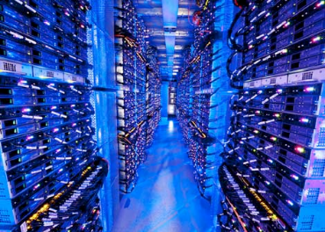
Data center networks
10’s to 100’s of thousands of hosts, often closely coupled, in close proximity:
  e-business (e.g. Amazon)
  content-servers (e.g., YouTube, Akamai, Apple, Microsoft)
  search engines, data mining (e.g., Google)
challenges:
  multiple applications, each serving massive numbers of clients
  managing/balancing load, avoiding processing, networking, data bottlenecks
Inside a 40-ft Microsoft container,
Chicago data center

Slide 105
Datacenter networks: network elements
Border routers
connections outside datacenter
Tier-1 switches
connecting to ~16 T-2s below
Tier-2 switches
connecting to ~16 TORs below
…
…
…
…
Top of Rack (TOR) switch
one per rack
40-100Gbps Ethernet to blades
…
…
…
…
Server racks
20- 40 server blades: hosts

Slide 106
Data center networks
load balancer: application-layer routing
receives external client requests
directs workload within data center
returns results to external client (hiding data center internals from client)
Internet
Border router
Load
balancer
Load
balancer
Access router
B
Tier-1 switches
A
C
Tier-2 switches
TOR switches
Server racks
1
2
3
4
5
6
7
8

Slide 107
Data center networks
rich interconnection among switches, racks:
  increased throughput between racks (multiple routing paths possible)
  increased reliability via redundancy
Tier-1 switches
Tier-2 switches
TOR switches
Server racks
1
2
3
4
5
6
7
8

Slide 108
Link layer, LANs: outline
6.1 introduction, services
6.2 error detection, correction
6.3 multiple access protocols
64 LANs
  addressing, ARP
  Ethernet
  switches
  VLANS
6.5 data center networking
6.6 a day in the life of a web request

Slide 109
Synthesis: a day in the life of a web request
journey down protocol stack complete!
  application, transport, network, link
putting-it-all-together: synthesis!
  goal: identify, review, understand protocols (at all layers) involved in seemingly simple scenario: requesting www page
  scenario: student attaches laptop to campus network, requests/receives www.google.com

Slide 110





A day in the life: scenario
browser
DNS server
Comcast network
68.80.0.0/13
school network
68.80.2.0/24
web page
web server
Google’s network
64.233.160.0/19
64.233.169.105

Slide 111

A day in the life… connecting to the Internet
DHCP
DHCP
UDP
IP
Eth
Phy
connecting laptop needs to get its own IP address, addr of first-hop router, addr of DNS server: use DHCP
DHCP
DHCP
DHCP
DHCP
DHCP request encapsulated in UDP, encapsulated in IP, encapsulated in 802.3 Ethernet
DHCP
DHCP
UDP
IP
Eth
Phy
DHCP
DHCP
DHCP
DHCP
router
(runs DHCP)
Ethernet frame broadcast (dest: FFFFFFFFFFFF) on LAN, received at router running DHCP server
Ethernet demuxed to IP demuxed, UDP demuxed to DHCP

Slide 112
A day in the life… connecting to the Internet
DHCP
DHCP
UDP
IP
Eth
Phy
DHCP server formulates DHCP ACK containing client’s IP address, IP address of first-hop router for client, name & IP address of DNS server
DHCP
DHCP
DHCP
encapsulation at DHCP server, frame forwarded (switch learning) through LAN, demultiplexing at client
DHCP
DHCP
UDP
IP
Eth
Phy
DHCP
DHCP
DHCP
router
(runs DHCP)
DHCP
DHCP client receives DHCP ACK reply
Client now has IP address, knows name & addr of DNS
server, IP address of its first-hop router

Slide 113
A day in the life… ARP (before DNS, before HTTP)
DNS
UDP
IP
Eth
Phy
before sending HTTP request, need IP address of www.google.com: DNS
DNS
DNS
DNS
ARP
ARP query
DNS query created, encapsulated in UDP, encapsulated in IP, encapsulated in Eth. To send frame to router, need MAC address of router interface: ARP
ARP
ARP reply
Eth
Phy
ARP query broadcast, received by router, which replies with ARP reply giving MAC address of router interface
router
(runs DHCP)
client now knows MAC address of first hop router, so can now send frame containing DNS query

Slide 114
A day in the life… using DNS
DNS
UDP
IP
Eth
Phy
DNS
DNS server
DNS
UDP
IP
Eth
Phy
DNS
DNS
DNS
DNS
DNS
DNS
DNS
DNS
Comcast network
68.80.0.0/13
IP datagram forwarded from campus network into Comcast network, routed (tables created by RIP, OSPF, IS-IS and/or BGP routing protocols) to DNS server
router
(runs DHCP)
IP datagram containing DNS query forwarded via LAN switch from client to 1st hop router
demuxed to DNS server
DNS server replies to client with IP address of www.google.com

Slide 115
A day in the life…TCP connection carrying HTTP
HTTP
HTTP
TCP
IP
Eth
Phy
SYNACK
SYN
SYNACK
SYN
SYNACK
SYN
SYN
to send HTTP request, client first opens TCP socket to web server
router
(runs DHCP)
TCP
IP
Eth
Phy
TCP SYN segment (step 1 in 3-way handshake) inter-domain routed to web server
SYNACK
SYN
SYNACK
SYN
SYNACK
SYNACK
SYN
web server responds with TCP SYNACK (step 2 in 3-way handshake)
web server
64.233.169.105
TCP connection established!

Slide 116
A day in the life… HTTP request/reply
HTTP
HTTP
TCP
IP
Eth
Phy
web page finally (!!!) displayed
HTTP
HTTP
HTTP
HTTP
HTTP
HTTP
HTTP
HTTP
HTTP request sent into TCP socket
router
(runs DHCP)
IP datagram containing HTTP request routed to www.google.com
HTTP
HTTP
TCP
IP
Eth
Phy
HTTP
HTTP
HTTP
web server responds with HTTP reply (containing web page)
HTTP
web server
64.233.169.105
IP datagram containing HTTP reply routed back to client

Slide 117
Chapter 6: Summary
principles behind data link layer services:
  error detection, correction
  sharing a broadcast channel: multiple access
  link layer addressing
instantiation and implementation of various link layer technologies
  Ethernet
  switched LANS, VLANs
synthesis: a day in the life of a web request

Slide 118
Chapter 6: let’s take a breath
journey down protocol stack complete (except PHY)
solid understanding of networking principles, practice
….. could stop here …. but lots of interesting topics!
  wireless
  multimedia
  security

